Slide 1

Willamette University School of Computing and Information Sciences
Masters in Data Science
Capstone Project
Healthcare Access and its Effects on Coronary Heart Disease Prevalence
Isaac Johnson & Jesse DeBolt
August 2023

Slide 2
01
Does living in a rural area make you more prone to coronary heart disease?
What might be the potential effect of policy interventions aimed at reducing these disparities?
02
What are some of the factors that contribute to coronary heart disease?
How do those factors affect the prevalence of coronary heart disease for those in rural counties.
Notes:
Research question

Slide 3
Heart Disease
In America
Heart disease is the leading cause of death for men, women, and people of most racial and ethnic groups in the United States.¹
One person dies every 33 seconds in the United States from cardiovascular disease.¹
About 695,000 people in the United States died from heart disease in 2021—that’s 1 in every 5 deaths.^{1,2}
Heart disease cost the United States about $239.9 billion each year from 2018 to 2019.³ This includes the cost of health care services, medicines, and lost productivity due to death.
Notes:
Why important

Slide 4
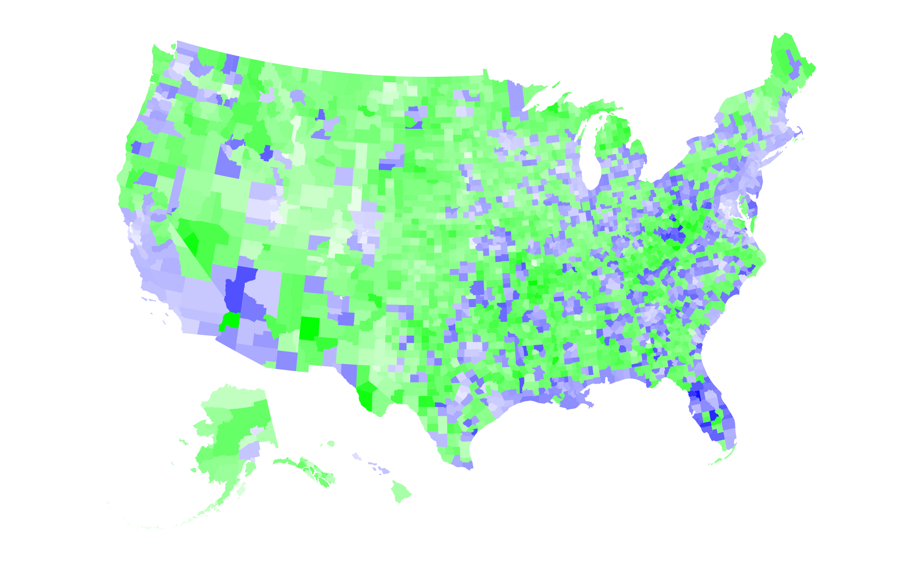

Coronary Heart Disease Prevalence
Urban
Rural
Notes:
Boom - main result. MAP

Slide 5
Coronary Heart Disease
The impact of disparities, specifically the difference between urban and rural counties in healthcare access is one of the contributing factors.
Our research shows that those living in rural areas are more prone to heart disease than those in urban areas. Furthermore, there are additional contributing factors, that when compounded with the urban/rural consideration, add to the risk of greater coronary heart disease prevalence.
With the findings and insights from our research we have determined some policy making and interventions considerations in the healthcare sector.
Urban
Rural
Urban and Rural Counties
Notes:
if thinking of moving to rural, don’t
Considering these facts and what we found in our research you might want to reconsider if you already or are planning to move to a rural area.
Saw some reasons, Dive into why

Slide 6
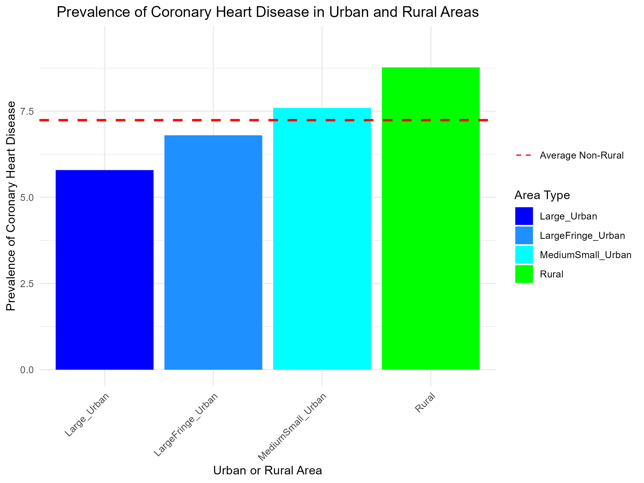
7.2%
CHD prevalence Urban Areas
8.7%
CHD prevalence Rural Areas
Urban versus Rural
Notes:
4 bar graph 7.2% vs 8.7%
National Center for Health Statistics

Slide 7
Project Methodology
Data Cleaning and Feature Engineering
Exploratory Data Analysis
Data Modeling

Slide 8
Project Methodology
Data Cleaning and Feature Engineering
Exploratory Data Analysis
Data Modeling

Slide 9
Data Engineering
Final dataset
Geographic, Health-specific, Demographic, Socio-economic
05
Ready for Analysis
04
Atlas via CDC
Comprehensive data containing much of the data from other sources, combined
Data Composition
03
Data Restructure
02
Atlas of Heart Disease and Stroke
Various data engineering techniques
01
Populated missing values with known data, imputing other missing data, separating variable, like county and state
Many valuable sources
Sources
CDC, Census Bureau, Country Health Rankings and Roadmaps, Centers for Medicare & Medicaid Services, Behavioral Risk Factor Surveillance System
Notes:
Found our data, CDC etc.
Don’t walk through #4

Slide 10
The Data:
Aorta
3140 Counties
Pulmonary
Artery
Left Atrium
Coronary
Artery
Pulmonary
Valve
Mitral
Valve
1165 Urban
Aortic
Valve
Right Atrium
Tricuspid
Valve
Left
Ventricle
1975 Rural
Right Ventricle
Social Economic | Environmental | Health Risk Factors |
Health Prevalence | Health Care Deliverance | Health Insurance
Notes:
bit about the variables? 3140 counties,

Slide 11
Project Methodology
Data Cleaning and Feature Engineering
Exploratory Data Analysis
Data Modeling

Slide 12
Project Methodology
Data Cleaning and Feature Engineering
Exploratory Data Analysis
Data Modeling

Slide 13

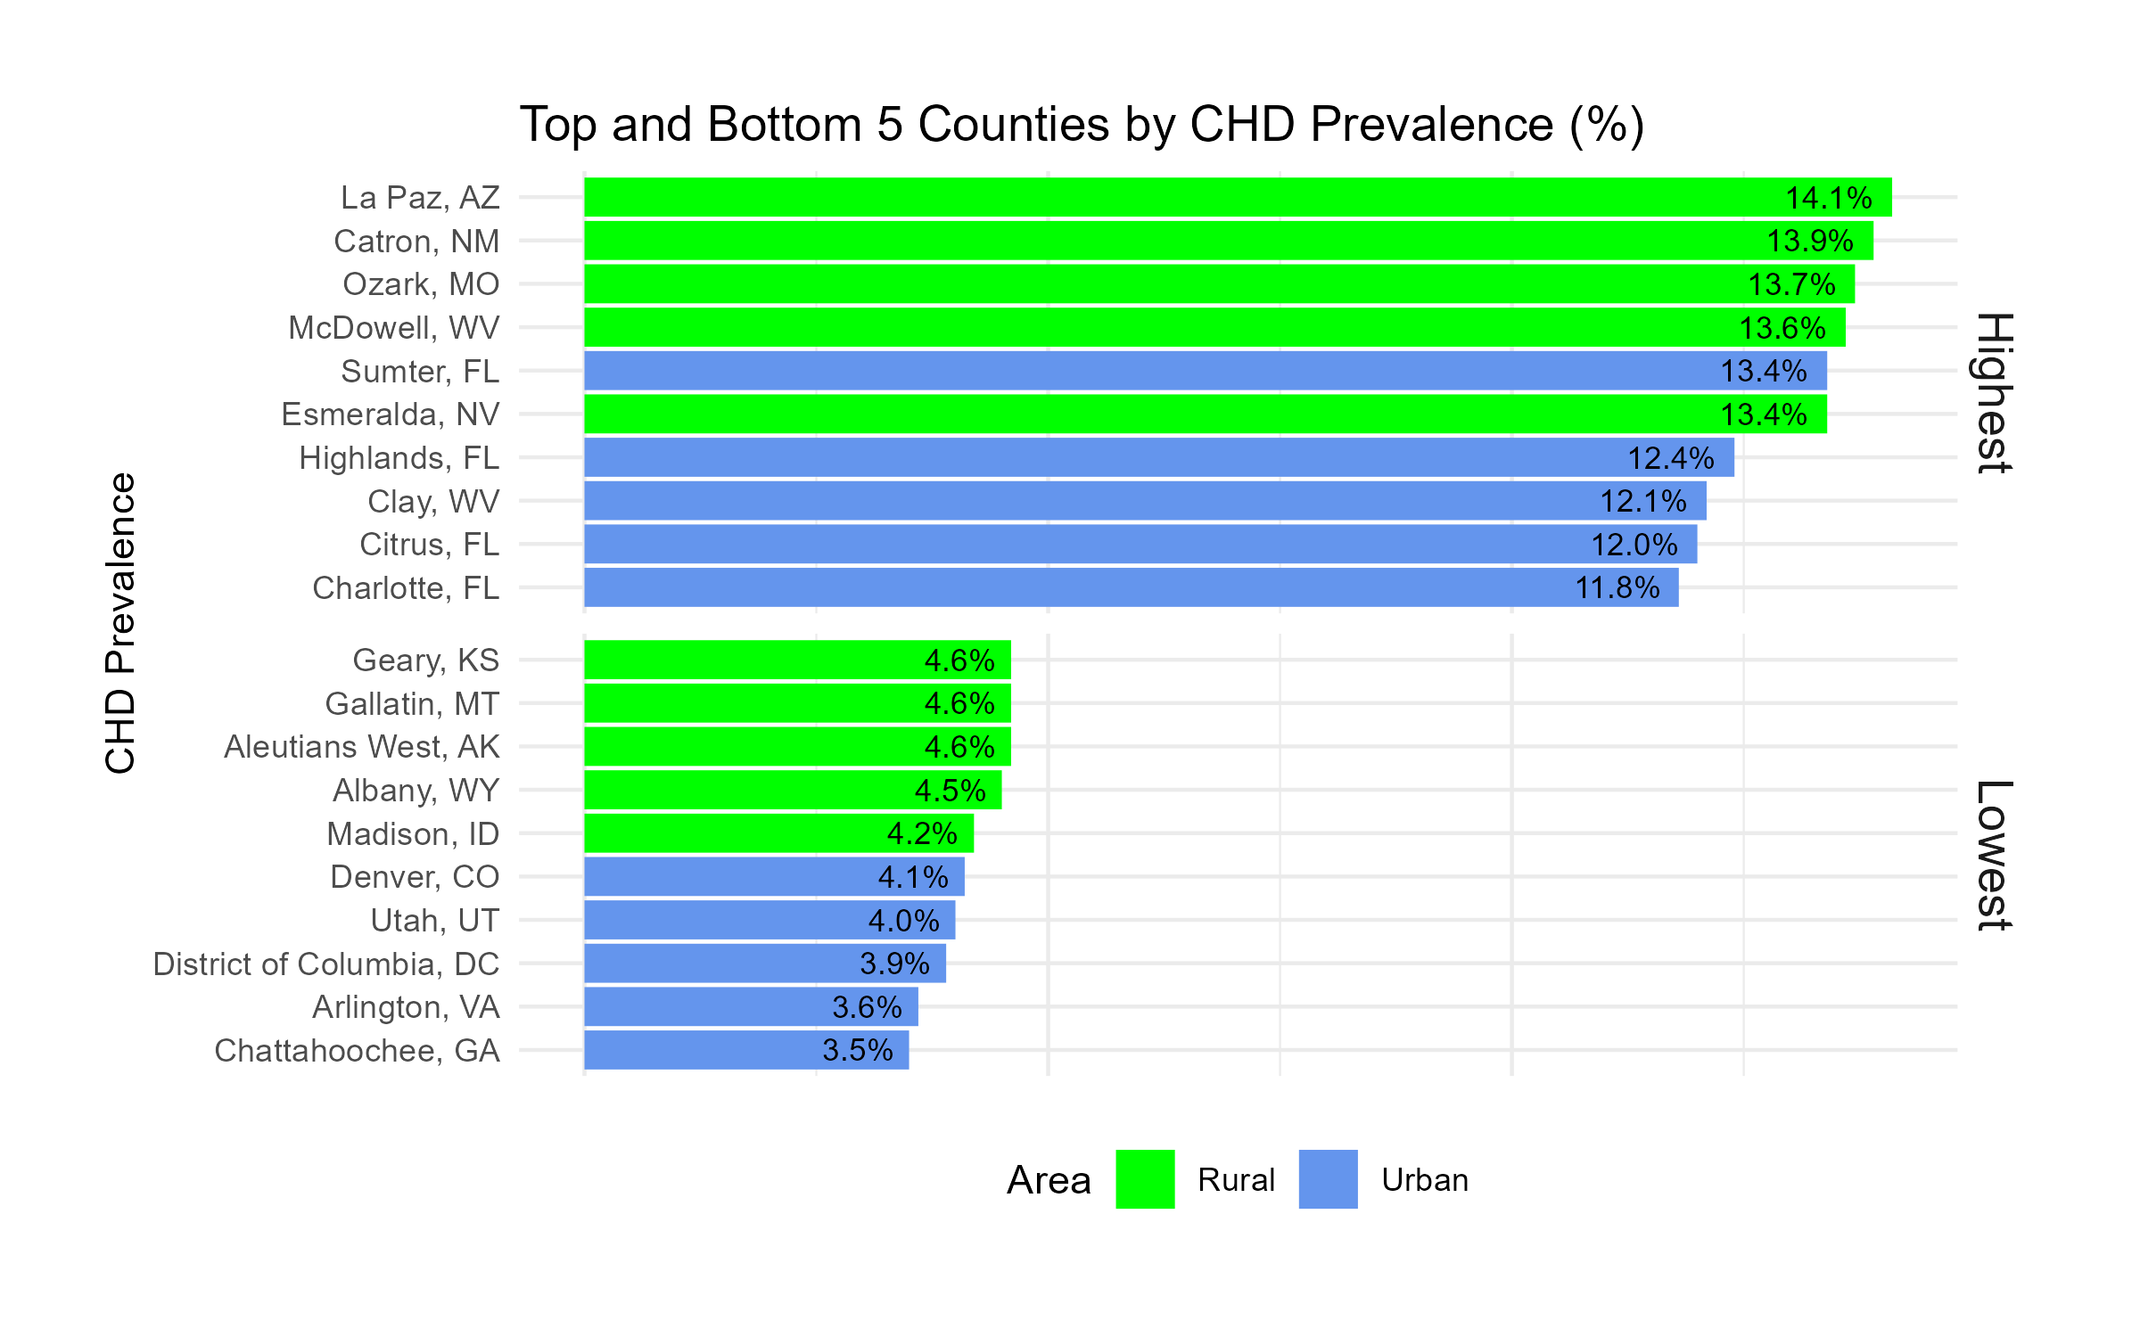
Coronary Heart Disease Prevalence
Notes:
?top 10 states urban/rural?
top 10 states highest/lowest prevalence (change to top counties?)
There is still a divide

Slide 14
0.9
2.2
per county – Rural
(7 per 100k residents)
per county – Urban
(1.7 per 100k residents)
Hospitals
258
38
per county – Rural
(127 per 1k residents)
per county – Urban
(152 per 1k residents)
Primary Care
23.1
14.6
Cardiovascular
per county – Rural
per county – Urban
20%
17%
Population
> 65 years – Rural
> 65 years – Urban
Notes:
?Healthcare facilities and professionals section, pop factors

Slide 15
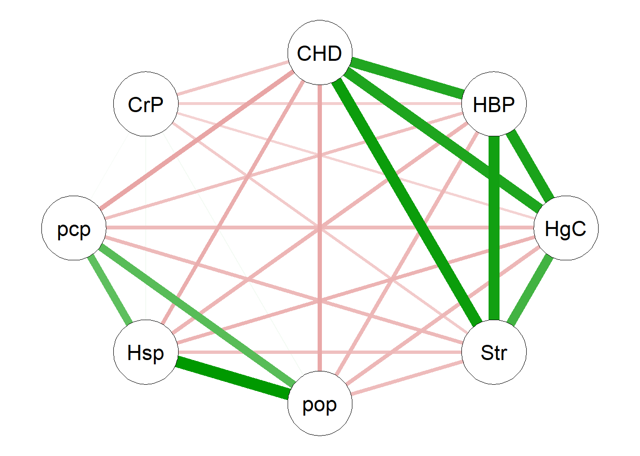
Correlation
Analysis
CHD
Coronary Heart Disease
pop
Population
CHD
High Blood Pressure
HBP
CHD
Hsp
Hospitals
HgC
High Cholesterol
pcp
Primary Care Physicians
CHD
Cardiovascular Physicians
Str
CrP
Stroke
Notes:
core analysis (your cool diamond-ish shaped correlation analysis plot)
Red not as strong
CHD only

Slide 16
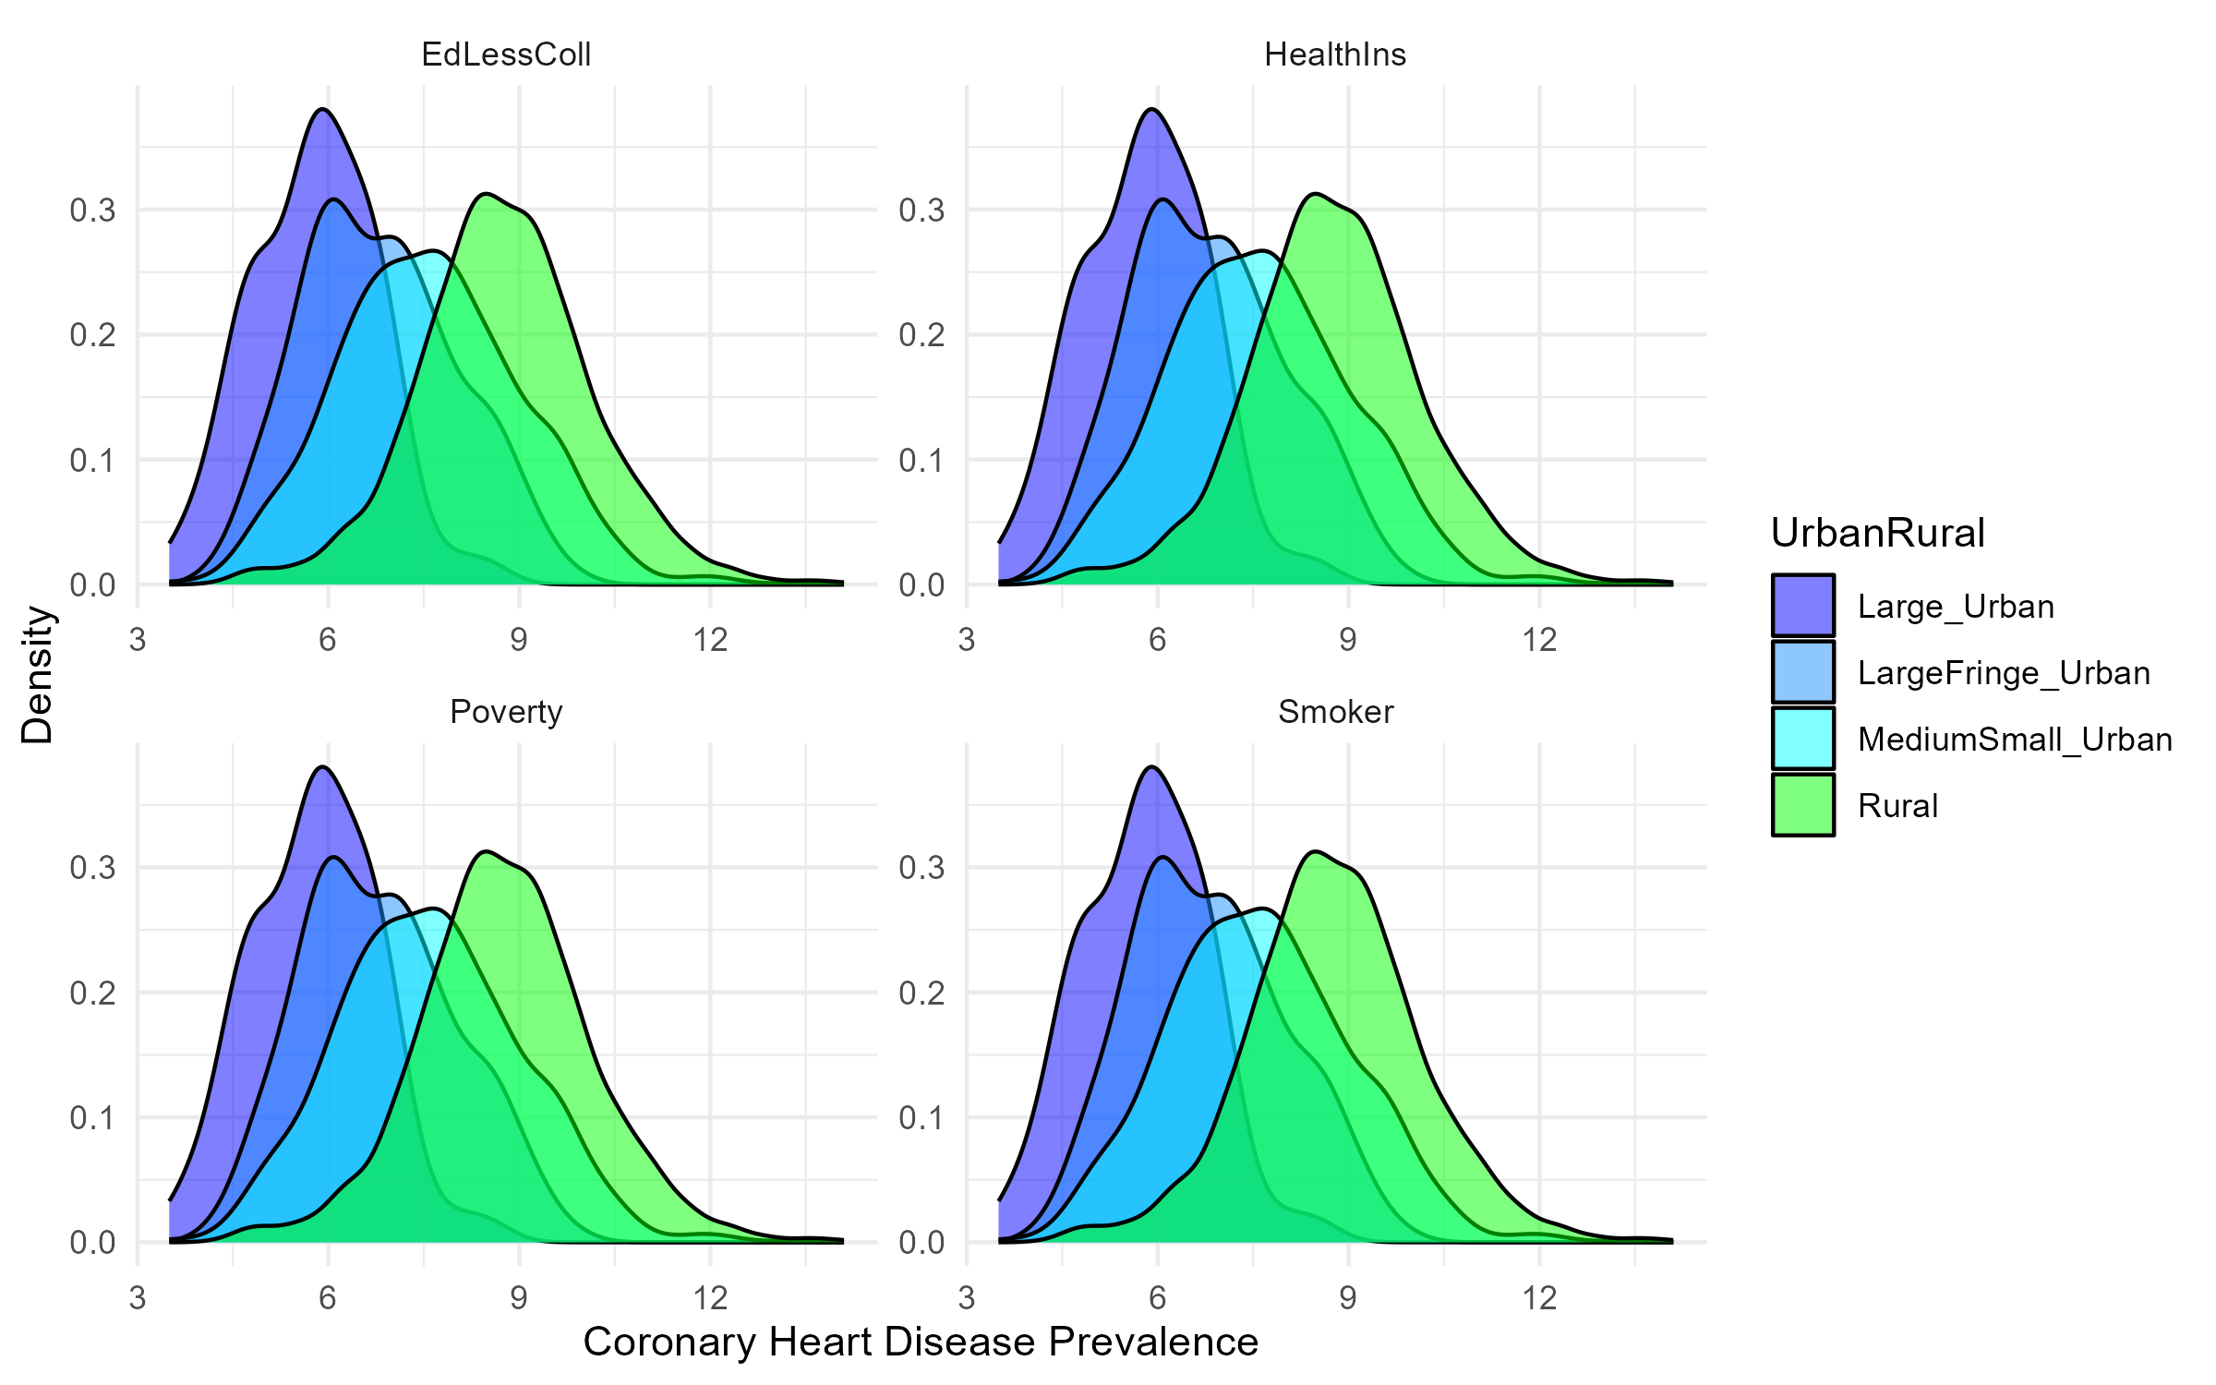
The Divide
Prevalence Urban
vs
Rural
Notes:
the 4 faceted mountain plots rural separate form urban

Slide 17
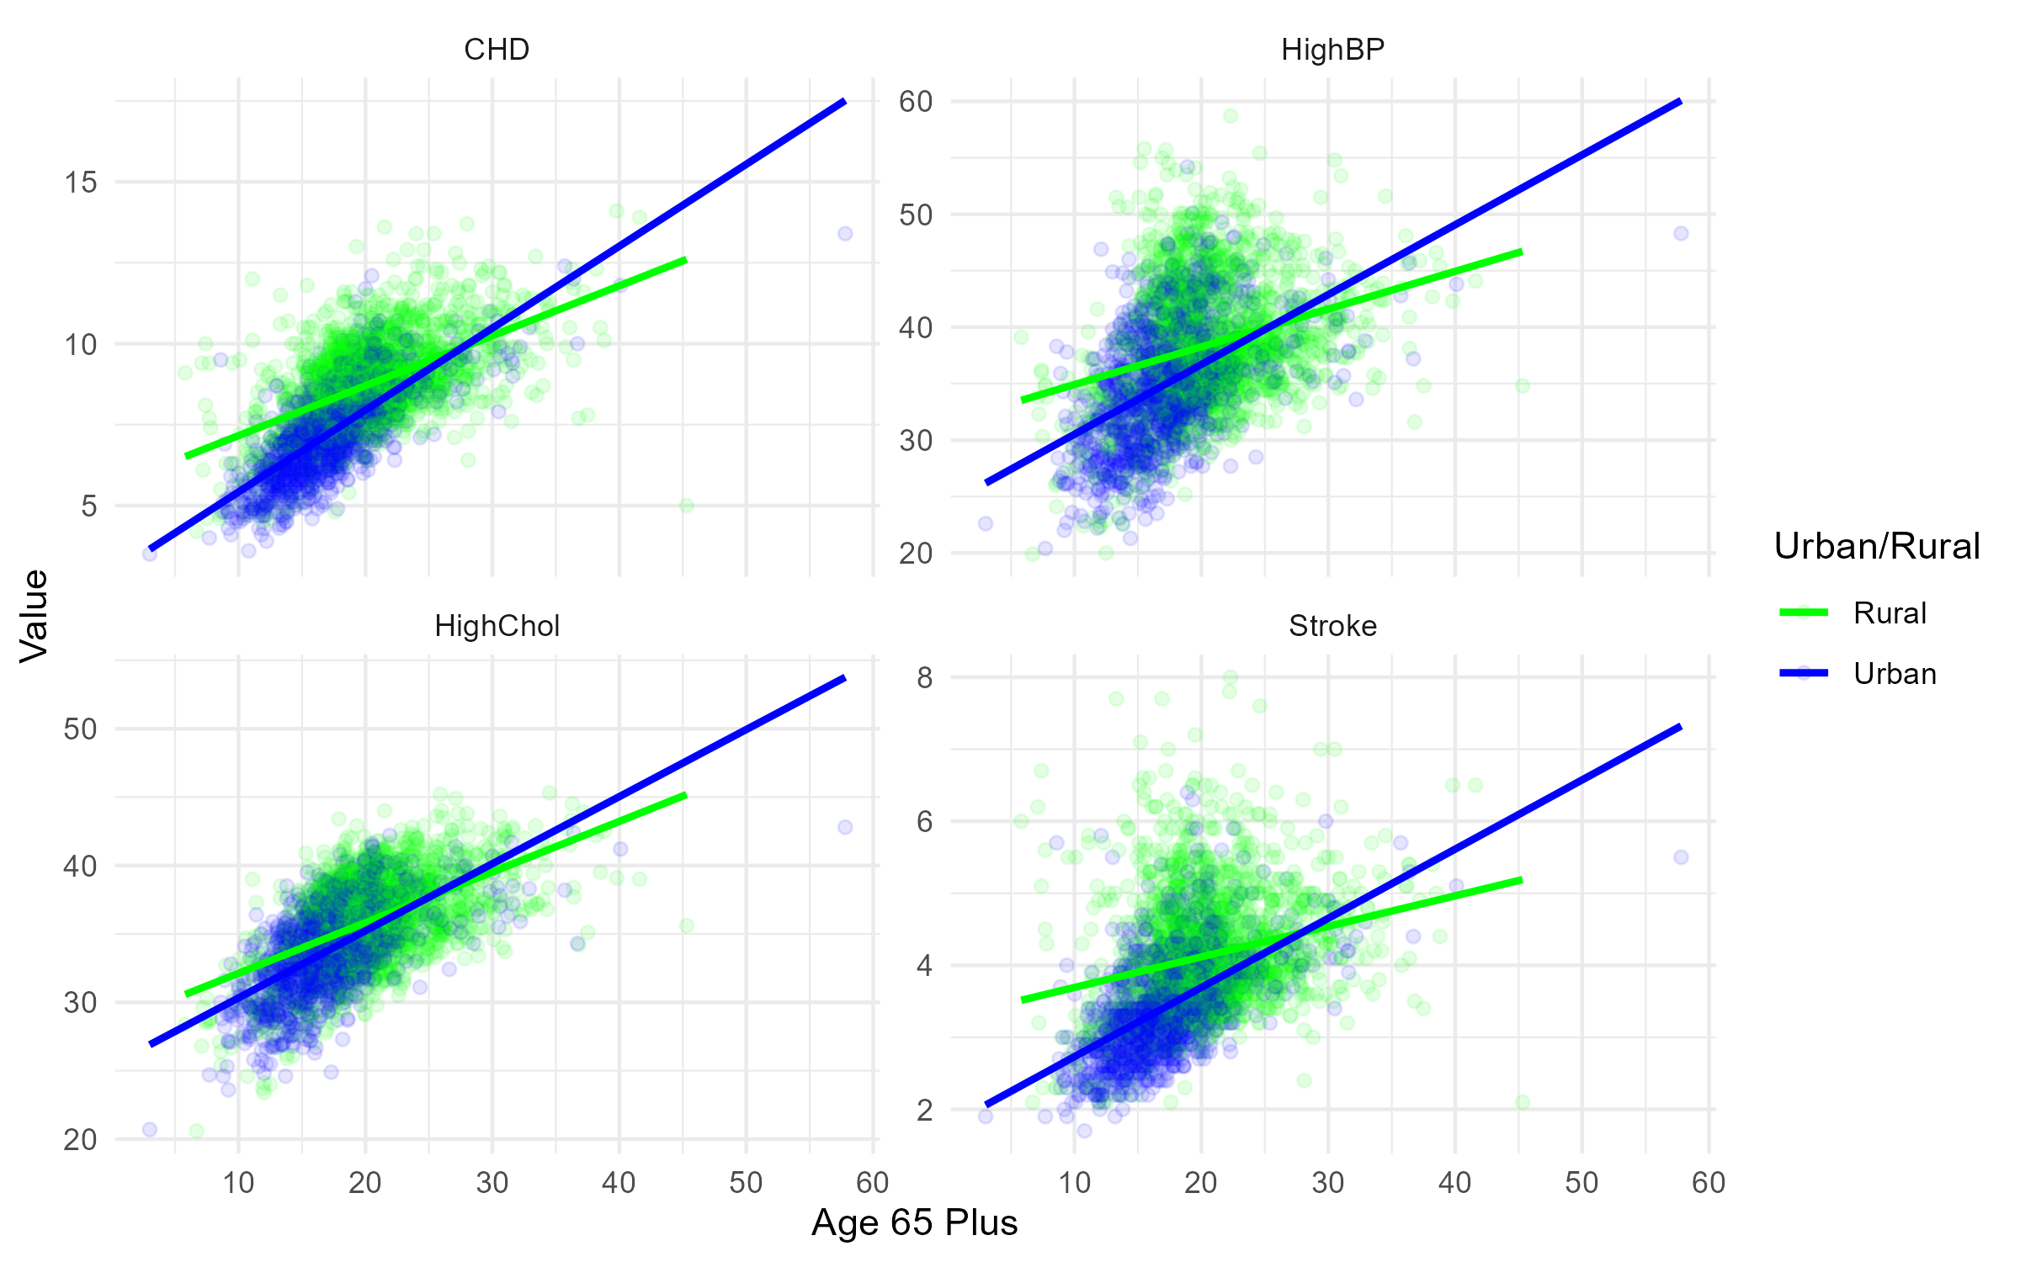
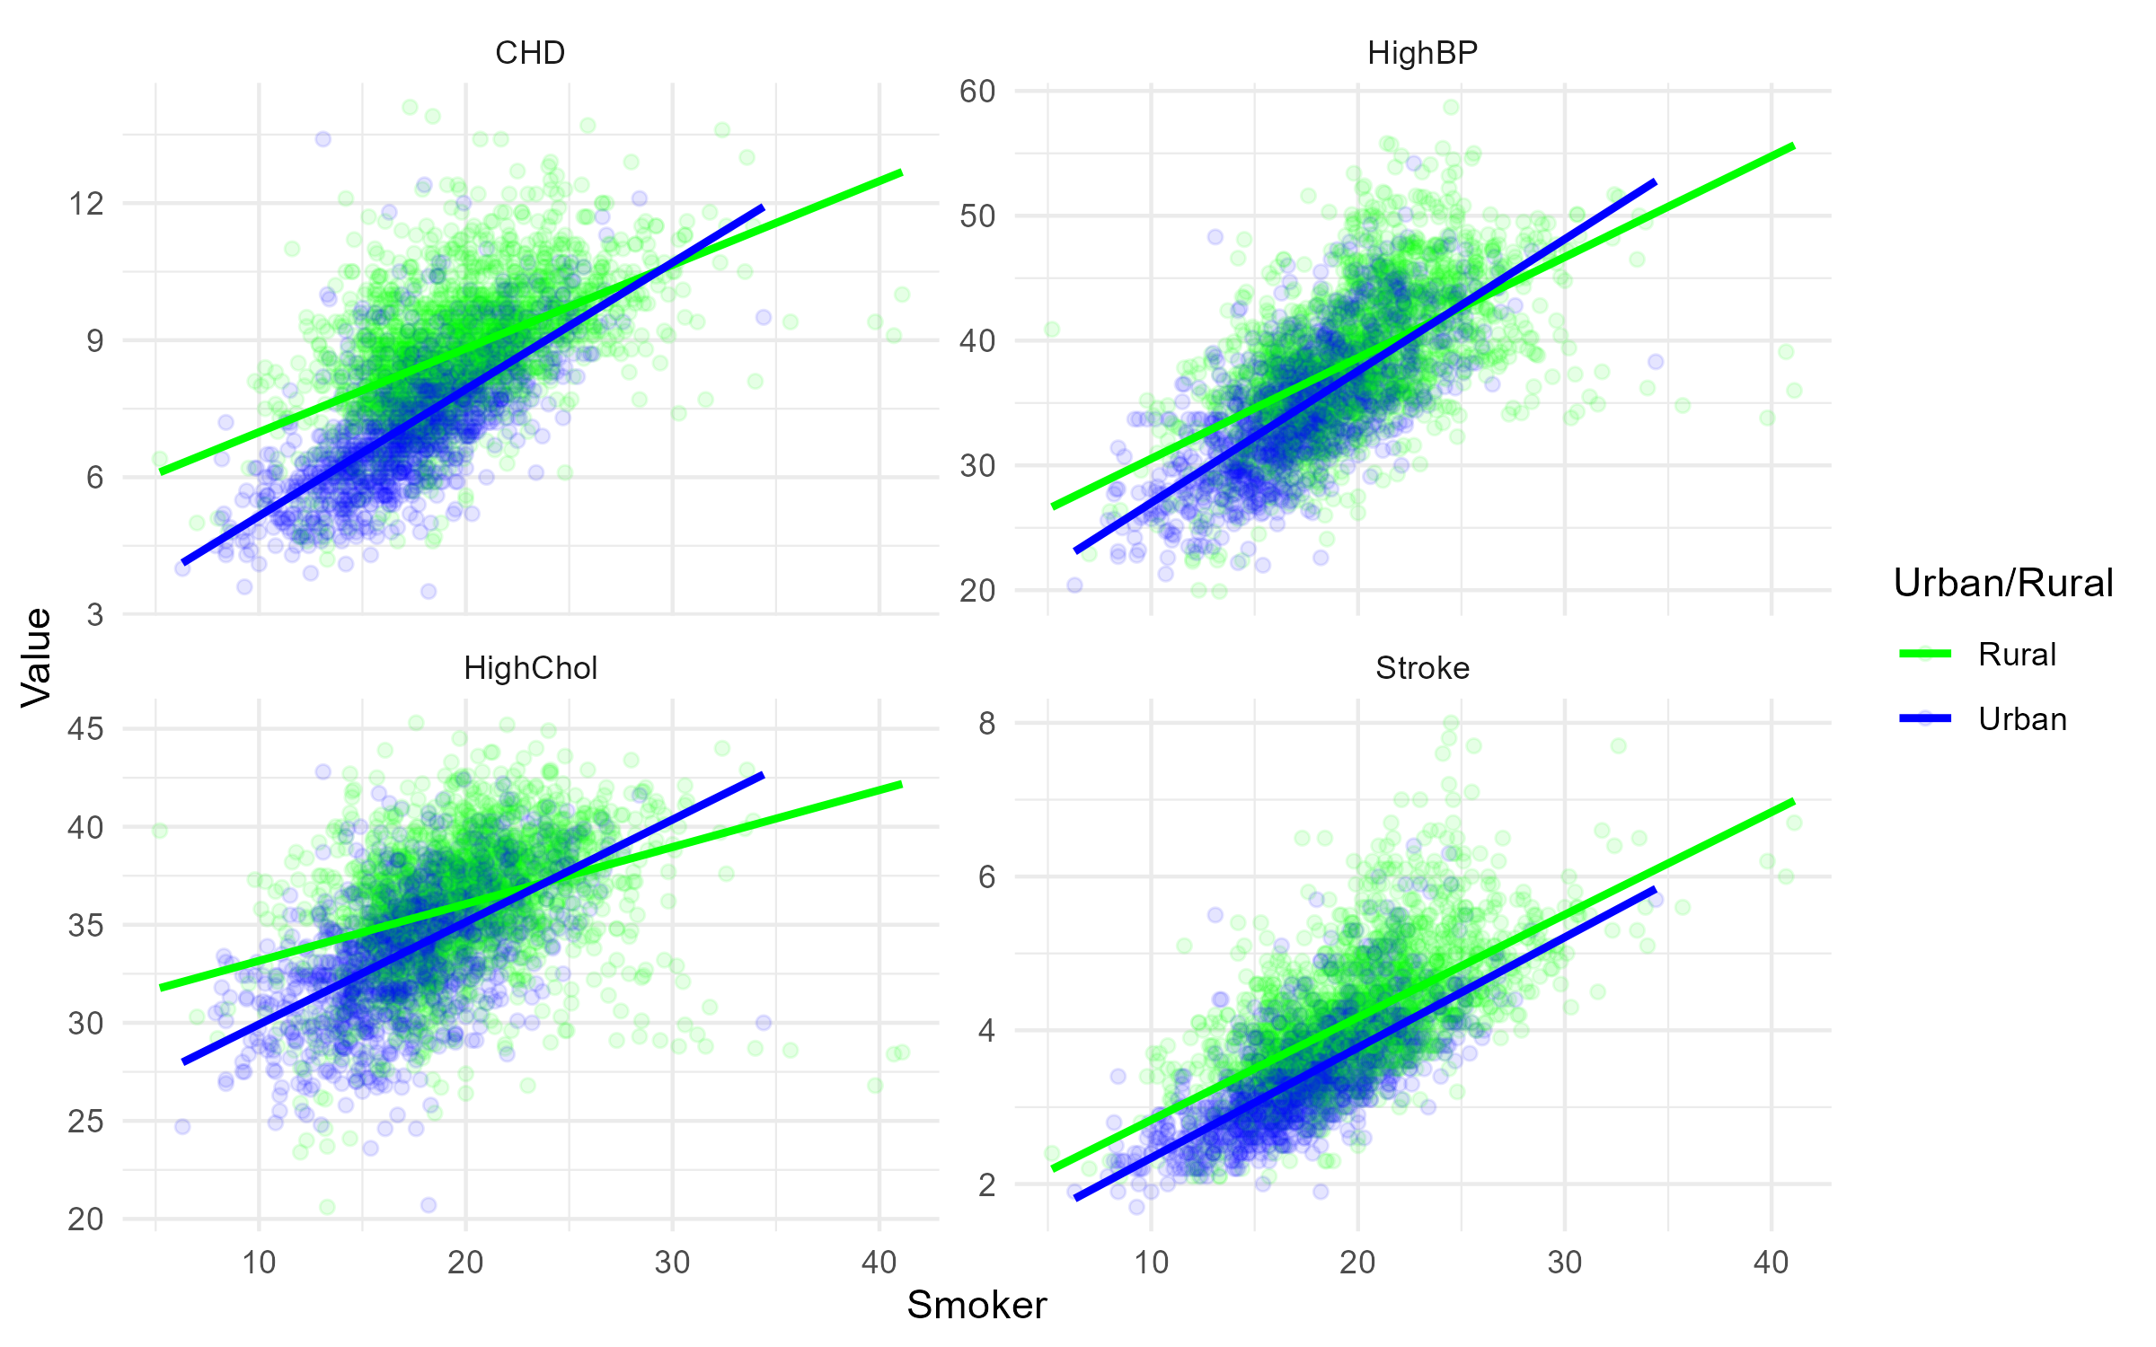
The Interactions
Prevalence Urban
vs
Rural
Notes:
Analysis top predictors 4 blue green scatter plots

Slide 18
Project Methodology
Data Cleaning and Feature Engineering
Exploratory Data Analysis
Data Modeling

Slide 19
Project Methodology
Data Cleaning and Feature Engineering
Exploratory Data Analysis
Data Modeling

Slide 20
Modeling Methods
A
Several various models
95%
5%
B
Ultimately used linear regression
C
Three variables accounted for 90% of the variance
D
Additional two variables accounted for another 5%
Notes:
We ran some models, some simple ones, some fancy ones, stuck to LM easier to explain and seems close to same accuracy (explained about 95% of the variance)
What we found: top 5 variables for CHD (stroke Age65 smoker highchol high-up)

Slide 21

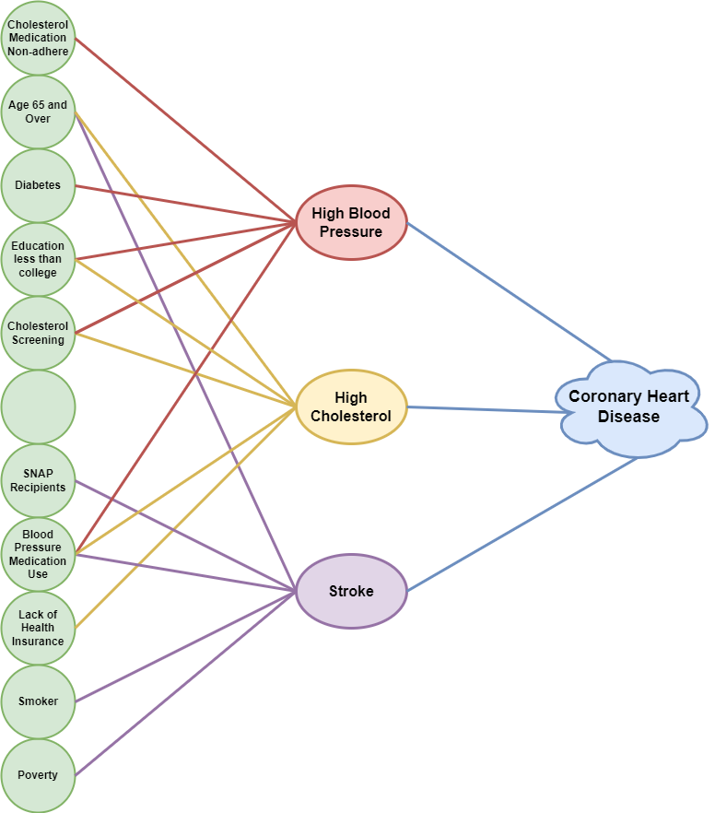
Notes:
ran more models looked at stroke high cool HBP
top variables bubble plot #1

Slide 22
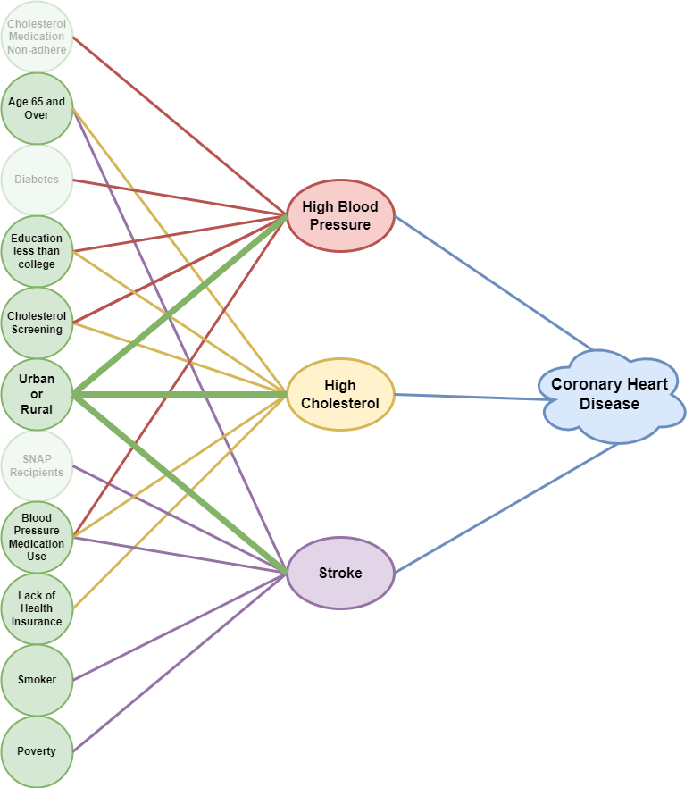
Notes:
top variables bubble plot #1

Slide 23
Reducing Coronary Heart Disease Prevalence
With an urban or rural context, the factors most amenable to adjustment include education, health insurance, smoking, and poverty.
Health advocates or coaches who are accessible to those who find it difficult to seek help and gain understanding.
Provision of telemedicine options and mail-order prescriptions at reduced costs.
Further research could help us identify other factors that could contribute to reducing the prevalence of coronary heart disease.
Notes:
Recommendations
Further research could be smoking cessation programs and look into the effectiveness of those.

Slide 24
Healthcare Access and its Effects on
Coronary Heart Disease Prevalence
Research
Analysis
Solutions
Notes:
Conclusions
Difference between Urban and rural, we’ve shown the most important variables that impact CHD (xyz) and our recommendations, so again if you’re considering moving to a rural area we’d suggest second thinking that

Slide 25

THANK YOU

Slide 26
Questions?

Slide 27
References:
National Center for Health Statistics. Multiple Cause of Death 2018–2021 on CDC WONDER Database. Accessed February 2, 2023.
Tsao CW, Aday AW, Almarzooq ZI, Beaton AZ, Bittencourt MS, Boehme AK, et al. Heart Disease and Stroke Statistics—2023 Update: A Report From the American Heart Association. Circulation. 2023;147:e93–e621.
National Center for Health Statistics. Percentage of coronary heart disease for adults aged 18 and over, United States, 2019—2021. National Health Interview Survey. Accessed February 17, 2023.
Center for Disease Control. Interactive Atlas of Heart Disease and Stroke. Accessed June 24, 2023. https://nccd.cdc.gov/DHDSPAtlas/?state=County

